Slide 1
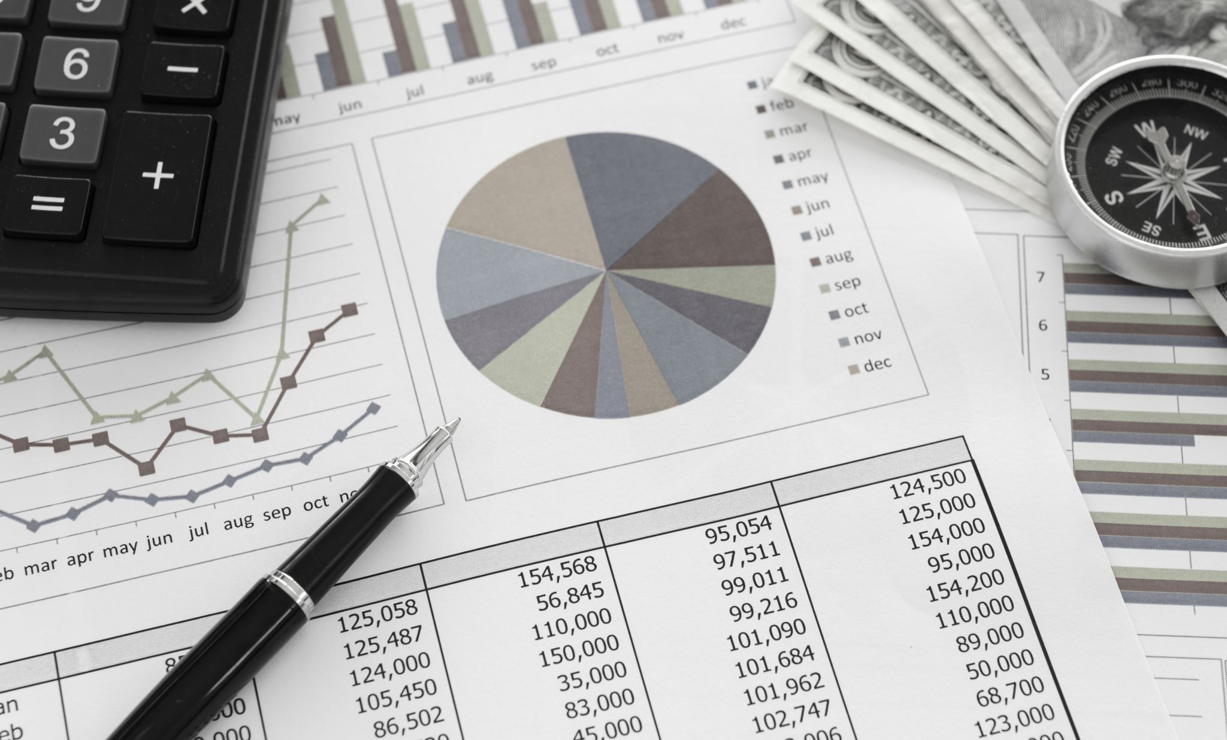
Finance Project 3
By: Gavin Bowen

Slide 2
Project Tasks
Review the Last Four US Bear Markets
Research the Catalysts
Analyze the Performance of Other Asset Classes
Understand Who the Federal Reserve is, and What Actions They Decided to Take
Highlight important Macroeconomic Data Associated, Such as Peak and Trough Dates
Predict Probability of a Recession Happening During Next 12 Months

Slide 3

Federal Reserve
Monetary policy with 2 goals: inflation & unemployment
2% Inflation and lowest unemployment that can support
Money supply & Interest rates
Reserve requirement ratio & federal funds rate (banks lending to each other)
Treasury bonds to control liquidity
Economic overheat example: if economy might reach total capacity, Fed can increase interest rates/federal funds rate

Slide 4

Dotcom Bubble Pop – Backstory
Started in 1995 and ended later months of 2002
Rise of tech stocks
Rampant IPOs (486 in 1999)
First day IPO returns (avg. 73%)
80% of companies never even made a profit
By 2004, 48% did not exist

Slide 5
Dotcom Bubble Pop – Catalyst
“Speculative or fad-based investing, the abundance of venture capital funding for startups, and the failure of dotcoms to turn a profit” - Investopedia
Investors enthusiasm
1999 IPO’s raised $69 billion; 2020 only had $78 billion
2nd argument of Fed rate hikes

Slide 6
Dotcom Bubble Pop – Fed Behavior
Initially lowered rates in 1999 because of global worries like Russian debt default
Interesting choice because of Greenspan’s “Irrational Exuberance” speech
Began to raise rates aggressively in later months of 1999 due to economic overheat, but damage had been done

Slide 7
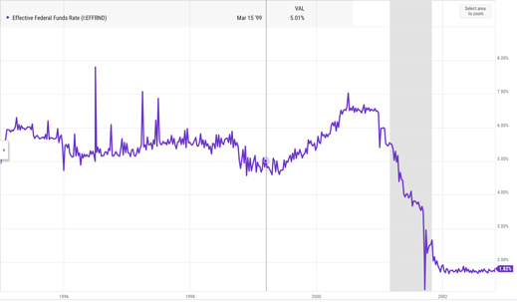
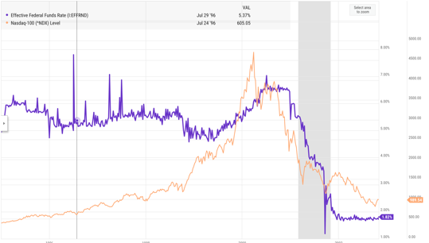

Slide 8
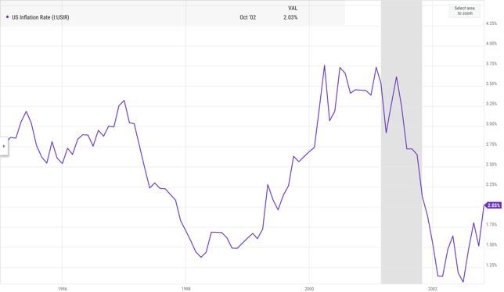
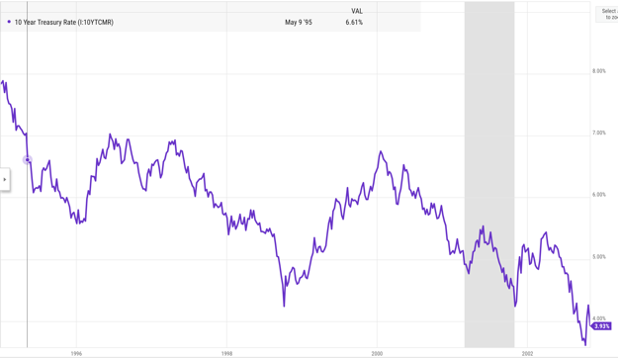
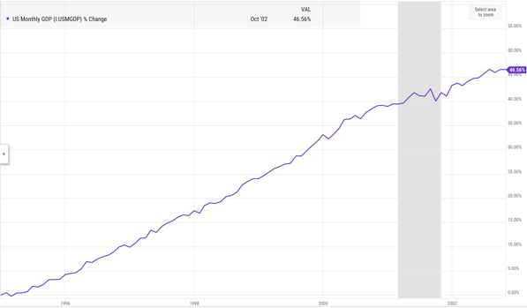
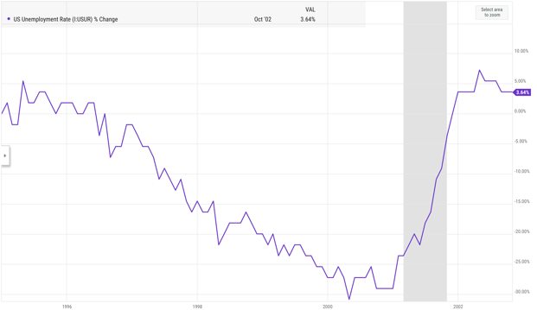
Dotcom Bubble Pop – Macro Data

Slide 9
Max | 1,527.46
Max Date | Friday, March 24, 2000
Min | 687.31
Min Date | Monday, September 30, 1996

Slide 10
Row Labels | Average of Close
1995 | 541.7191667
Qtr1 | 480.465873
Qtr2 | 524.4428571
Qtr3 | 564.7963492
Qtr4 | 597.1715873
1996 | 670.4950787
Qtr1 | 636.4547619
Qtr2 | 658.8520635
Qtr3 | 660.0976563
Qtr4 | 725.8620313
1997 | 873.4278656
Qtr1 | 784.7418033
Qtr2 | 823.489375
Qtr3 | 929.9442188
Qtr4 | 951.3789063
1998 | 1085.503016
Qtr1 | 1023.08918
Qtr2 | 1109.667143
Qtr3 | 1085.080625
Qtr4 | 1121.627031
1999 | 1327.329603
Qtr1 | 1260.492623
Qtr2 | 1329.643651
Qtr3 | 1341.986719
Qtr4 | 1374.098594
2000 | 1427.221071
Qtr1 | 1420.001429
Qtr2 | 1446.593651
Qtr3 | 1475.978889
Qtr4 | 1366.310317
2001 | 1194.178468
Qtr1 | 1273.325323
Qtr2 | 1234.251111
Qtr3 | 1153.707288
Qtr4 | 1115.367813
2002 | 1011.328957
Qtr1 | 1132.214833
Qtr2 | 1070.15
Qtr3 | 895.490625
Qtr4 | 854.6313043
Grand Total | 1015.722609

Slide 12
Global Financial Crisis – Backstory
December 1, 2007, to July 1, 2009
Considered by many worst economic crisis since Great Depression
Encouragement of home ownership by government and Fed (low interest rates)

Slide 13
Global Financial Crisis – Catalyst
Overenthusiasm about housing market
Glass Steagall -> more risk
Banks and financial institutions wanted a piece of the rapidly rising housing market
Riskier loans were provided because of the money made on the high interest rates -> ”subprime mortgages”
How could I invest in this! -> MBS and CDO
Companies borrowed heavy to create these funds and invest (Lehman 30:1)
All fun and games, but credit scores mean something

Slide 14
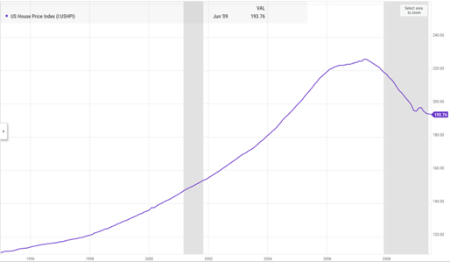
US Housing Market

Slide 15
Global Financial Crisis – Fed Behavior
Cut rates to near 0 instantly by December 2008 (5.25% 2007)
Stimulate economic demand
Discount window was expanded (emergency funds banks could borrow directly from Fed)
Traded MBS and CDO for Treasury securities
Bailouts and rescue programs -> fear of chain reactions
Bear Stearns to JP Morgan
American International Group to US Treasury

Slide 16
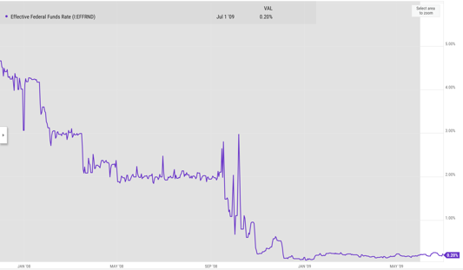
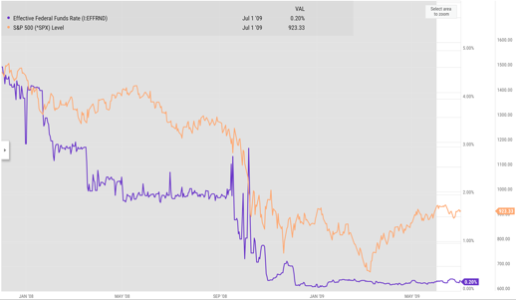

Slide 17
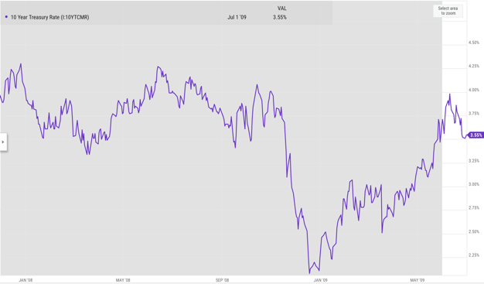
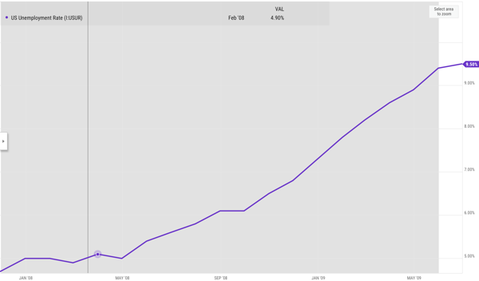
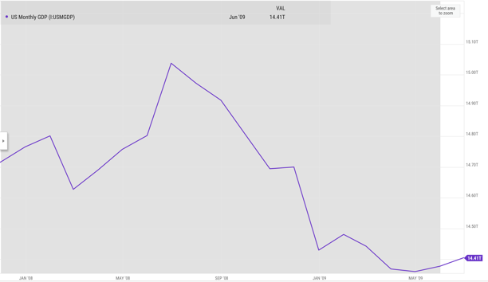
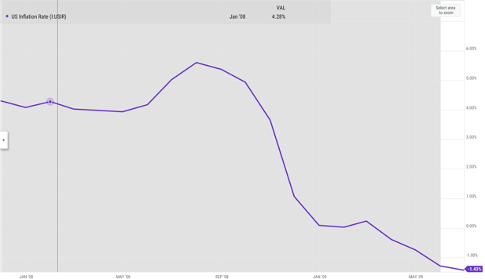
Global Financial Crisis – Macro Data

Slide 18
Max | 1,515.96
Max Date | Friday, December 7, 2007
Min | 676.53
Min Date | Monday, March 9, 2009

Slide 19
Row Labels | Average of Close
2007 | 1477.9655
Qtr4 | 1477.9655
Dec | 1477.9655
2008 | 1217.762569
Qtr1 | 1349.399672
Jan | 1376.300476
Feb | 1351.6685
Mar | 1318.885
Qtr2 | 1370.295156
Apr | 1372.249091
May | 1402.090476
Jun | 1336.452857
Qtr3 | 1250.084844
Jul | 1256.208182
Aug | 1282.294762
Sep | 1211.46
Qtr4 | 907.4410938
Oct | 960.3330435
Nov | 875.1410526
Dec | 880.0404545
2009 | 851.39872
Qtr1 | 807.6659016
Jan | 865.5755
Feb | 805.2273684
Mar | 757.1268182
Qtr2 | 892.6014286
Apr | 848.1519048
May | 902.4085
Jun | 926.115
Qtr3 | 923.33
Jul | 923.33
Grand Total | 1115.77407

Slide 21

COVID-19 – Backstory
Spanned the year of 2020
Was considered a pandemic in March 2020 by World Health Organization
Originated in Wuhan, China
US imposed lockdowns meant to keep people inside their homes and wear masks when in public

Slide 22

COVID-19 – Catalyst
Fear -> What could this be?
Lockdowns
Between February 19 and March 23 the S&P 500 dropped 34%
Abrupt halt of normalcy resulted in a sharp recession
Stimulus

Slide 23
COVID-19 – Fed Behavior
Similar to GFC, they cut federal funds rate tremendously
Ease economy and provide emergency lending
Quantitative easing -> buy back US Treasury bonds and MBS to inject liquidity
Market returned to pre-pandemic levels at an unprecedented speed

Slide 24
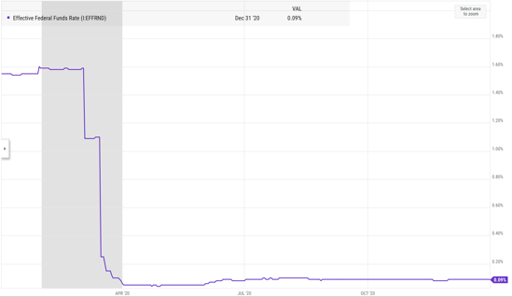
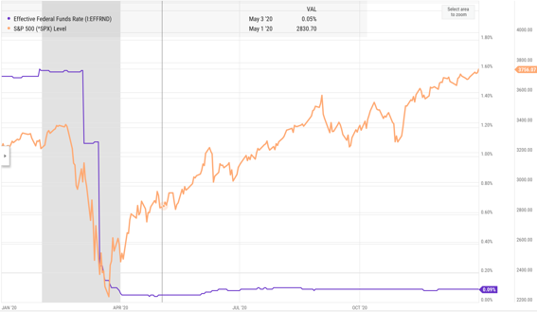

Slide 25
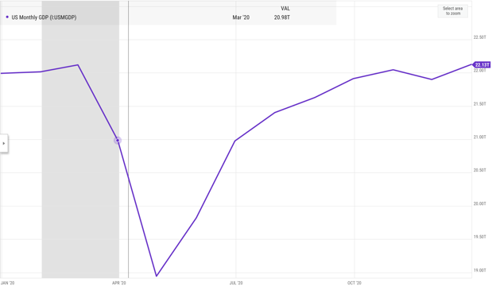
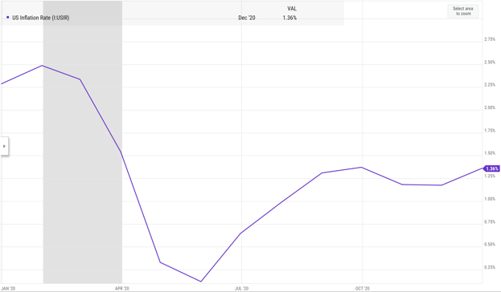
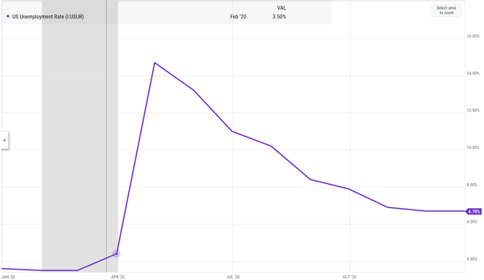
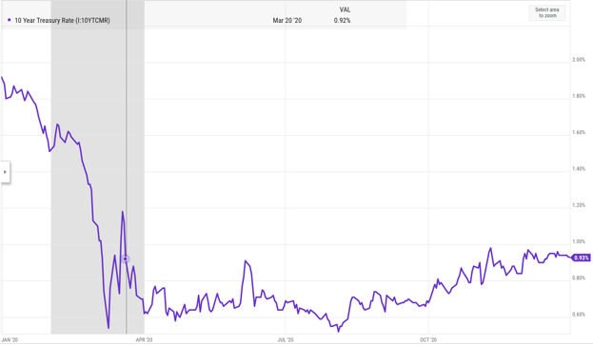
COVID-19 – Macro Data

Slide 26
Max | 3,756.07
Max Date | Thursday, December 31, 2020
Min | 2,237.40
Min Date | Monday, March 23, 2020

Slide 27
Row Labels | Average of Close
2020 | 3217.856482
Qtr1 | 3055.869194
Jan | 3278.202857
Feb | 3277.314211
Mar | 2652.393636
Qtr2 | 2931.687619
Apr | 2761.975238
May | 2919.615
Jun | 3104.660909
Qtr3 | 3319.834063
Jul | 3207.619091
Aug | 3391.71
Sep | 3365.516667
Qtr4 | 3554.501563
Oct | 3418.701364
Nov | 3548.9925
Dec | 3695.31
Grand Total | 3217.856482

Slide 29

2022 – Backstory
Not considered a recession
Began in January 2022 and ended October 2022
Believed to be economy aftershock from COVID-19
S&P 500 closed 20% down in October from January highs

Slide 30
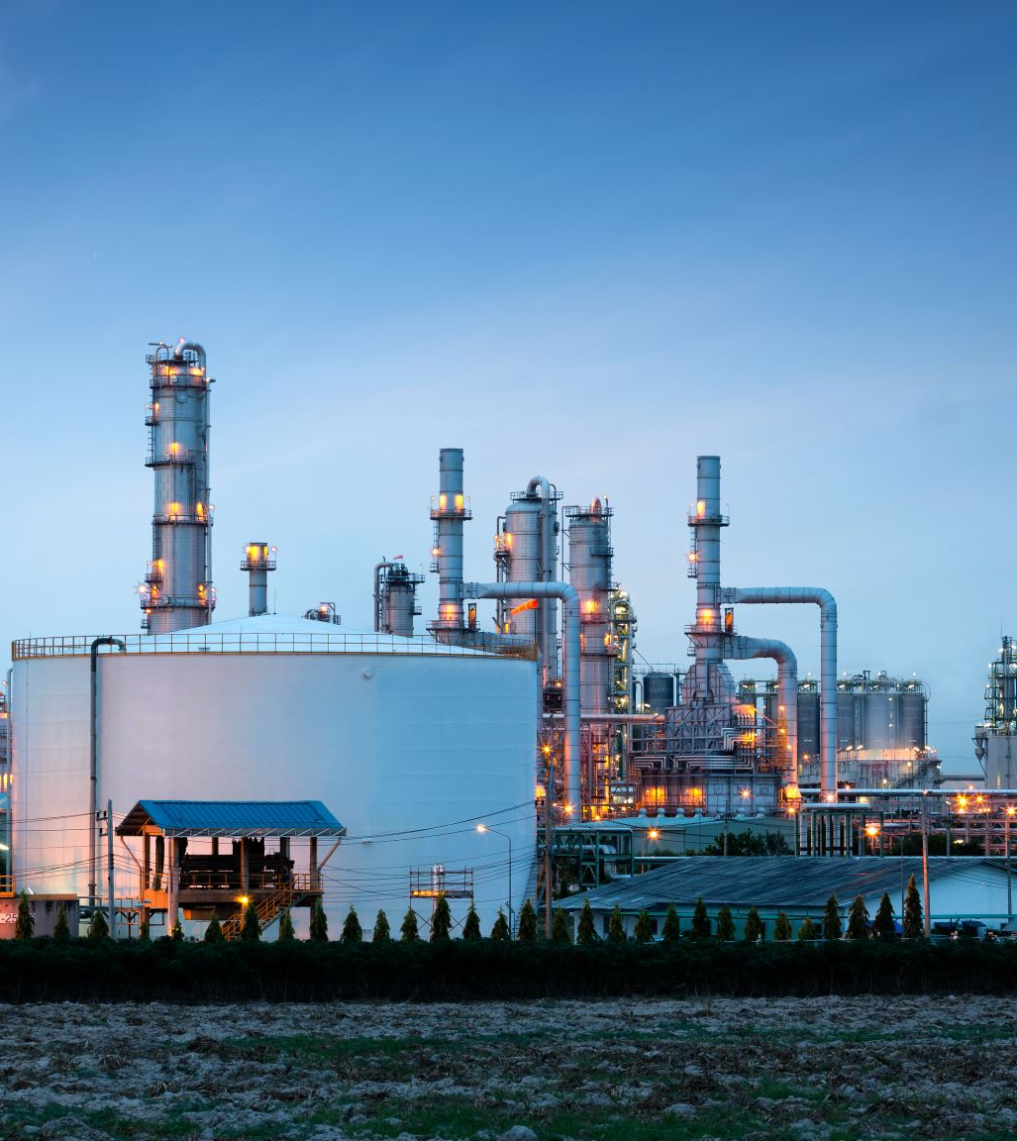
2022 – Catalyst
Very complex
Inflation reaching 9.06% in June 2022
Russian invasion of Ukraine; increased oil and gas prices (energy -> close correlation with inflation)
Global supply chain issues because of shortages created by COVID-19
Tech sector slowed returns
Cryptocurrency crash

Slide 31

2022 – Fed Behavior
Unique catalysts required unique Fed reaction
Hiked rates after near zero period post-COVID
Increased borrowing costs and pressured valuations, especially in tech
Quantitative tightening; allowed Treasury Securities and MBS to mature without reinvesting the profits (removing liquidity)

Slide 32
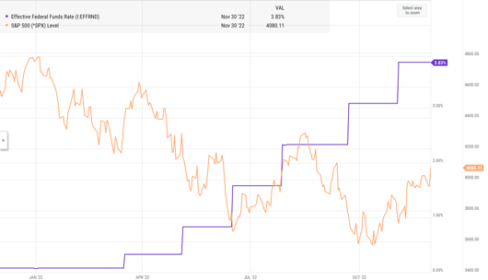
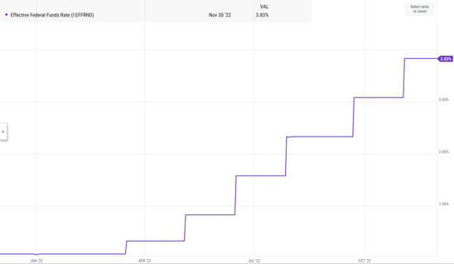

Slide 33
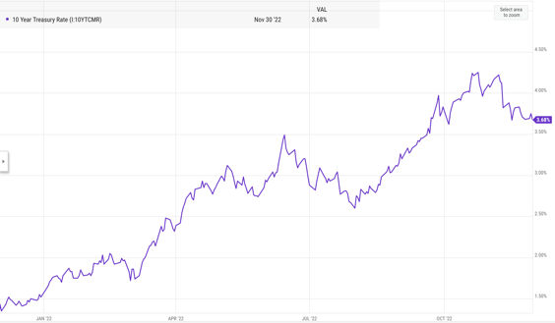
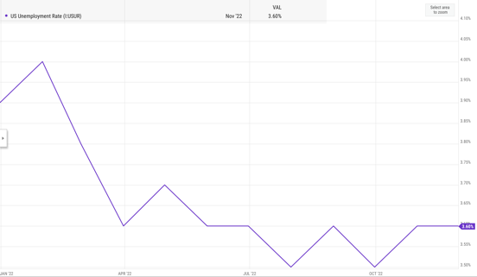
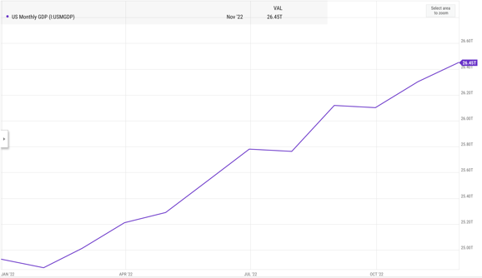
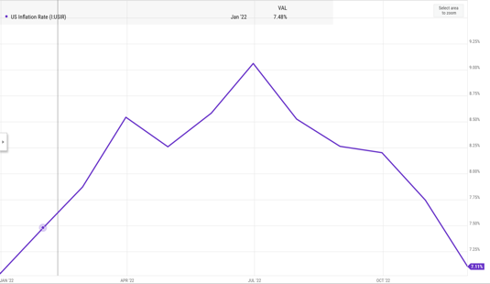
2022 – Macro Data

Slide 34
Max | 4,796.56
Max Date | Monday, January 3, 2022
Min | 3,577.03
Min Date | Wednesday, October 12, 2022

Slide 35
Row Labels | Average of Close
2021 | 4674.772727
Qtr4 | 4674.772727
Dec | 4674.772727
2022 | 4115.509565
Qtr1 | 4463.855484
Jan | 4573.8155
Feb | 4435.980526
Mar | 4391.265217
Qtr2 | 4105.667097
Apr | 4391.296
May | 4040.36
Jun | 3898.946667
Qtr3 | 3980.351094
Jul | 3911.7295
Aug | 4158.563043
Sep | 3850.520476
Qtr4 | 3821.769762
Oct | 3726.050952
Nov | 3917.488571
Grand Total | 4164.334127

Slide 37
Prediction (Pt. 1)
Things to consider:
Current interest rate of 5.33% highest since 6%+ in 2001; last time they were around this high was GFC at 5.29%
Cutting policy?
Housing is up 51.77% -> pressure from home buyers
While it has gotten better, 2.89% is not 2%
Unemployment has been on a slight uptick recently, going from 3.50% to 4.30% -> next jobs report is very important
High interest rates tend to lead to highly sensitive reactions from investors as they seem to realize their overenthusiasm and become skeptical

Slide 38
Prediction (Pt. 2)
Things to consider:
Much more active world than previous decades
Companies are still overvalued, and the S&P 500 is very high, but higher quality (tech), AI Dotcom theory is not true
US election year
Iran-Israel conflict
Russian-Ukraine conflict
Very high interest rate relative to last 25 years
Energy very volatile since COVID-19 and it closely relates to the inflation rate (heavy portion of CPI)
People want lower home mortgages

Slide 39
Prediction (Pt. 3)
Things to consider:
I believe rate cuts are due
If unemployment ticks upwards during next jobs report there is a very good chance (must be noted initial jobless claims is not up)
Political and consumer pressure
Extremely high S&P 500 (what else is new?)
Volatile energy
One misstep
75% chance
Furthered by the social issues mentioned previously, especially with market more sensitive with rates up

Slide 40
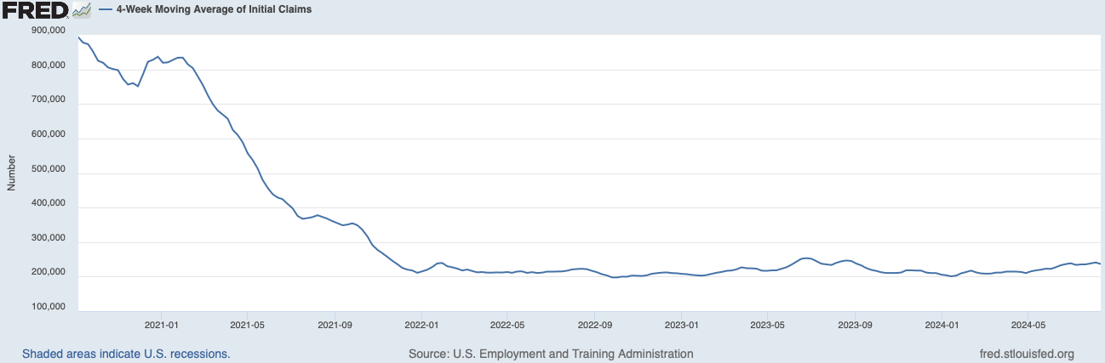

Slide 41
The Ideal
The ideal action for the Fed would be to cut rates by 0.25% to 0.50% steps, like how they were raised
Stability
What are the odds they get even this chance? They haven’t been able to the last 25 years and drastic circumstances call for drastic measures
They will be forced to play their cards more than they want due to the sensitive circumstances

Slide 42
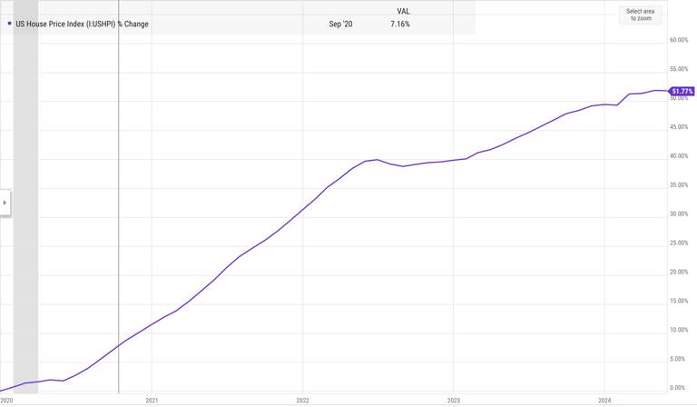

Slide 43
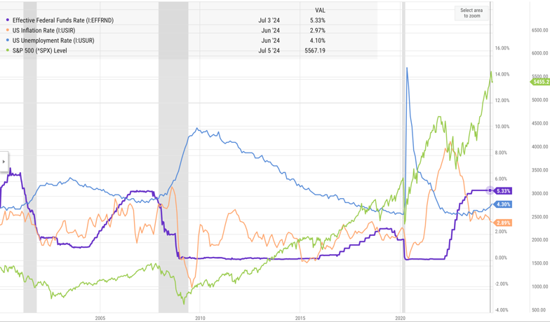

Slide 44
Learned Financial Concepts
Federal Reserve Functionality
Interest Rates
Monetary Policy
Inflation
Bear Markets
Federal Funds Rate
Required Reserve Ratio
Excess Funds
Supply & Demand
Dotcom Bubble
Global Financial Crisis
COVID-19
2022
IPO
Treasury Rates
Housing Markets
GDP
Unemployment
Investments
Macroeconomic Analysis

Slide 45
Learned Excel Functionality
FILTER Excel Generated Function
MINSIFS Excel Generated Function
Data Validation Tool
INDEX Excel Generated Function
MATCH Excel Generated Function
Dynamic Graphs
Using fn+f4 to make excel data ranges dynamic or static
Workbook Formatting
Interactive Chart Titles and TEXT Excel Generated Function
MAXIFS Excel Generated Function
ISNUMBER and IFERROR Excel Generated Functions
Graph Formatting
Cell Referencing
PivotTables
PivotCharts

